Slide 1

Airbnb
Group 8
Emely Callejas, Ashley Cortez,
Rithvik V Sourab, Angelica Verduzco

Slide 2
Case Background and Problem
Airbnb, launched in 2008 in San Francisco, and it has reshaped the hospitality industry. Homeowners can now lease their spaces to guests. This global platform acknowledges that renters across different regions have diverse preferences for property types and features.
In this case study, we focus on analyzing Airbnb’s data from Miami, FL, and Paris, France.
Linear Regression Analysis
Identify key factors influencing property occupancy rates in FL and France. Understand what key drivers help optimize the listings to improve occupancy and revenue
Topic Modeling of Review Texts
Review texts from properties in Miami and Paris, analysis is aimed to uncover trends of high versus low property ratings. This will help guide potential improvements in service quality and customers satisfaction

Slide 3
Linear Regression Models

Slide 4
Airbnb Dataset Variables
Dependent Variable: Occupancy
Independent Variables:
Miami:
log(price)
log(number of reviews +1)
Rating
log(accommodates)
Beds
Bedrooms
Bathrooms
log(minimum nights +1)
Host is superhost
Pro host
Entire home
Instant bookable
sentiment
Paris:
log(price)
log(number of reviews +1)
Rating
log(accommodates)
log(minimum nights +1)
Host is superhost
Pro host
Entire home
Instant bookable
Beds
Bedrooms
Bathrooms
sentiment

Slide 5
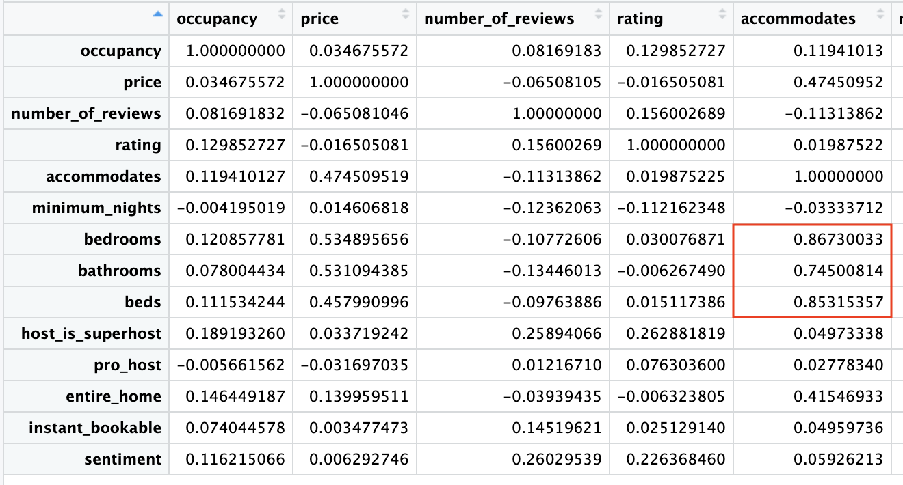
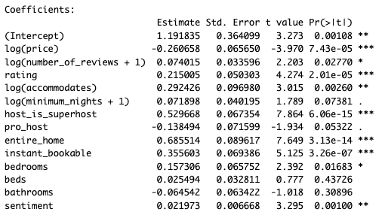

Variables Omitted from Linear Regression - Miami
Steps Taken to Decide which Variables to Omit
Correlation Matrix:
Multicollinearity between “accommodates” and “beds”, ”bathrooms”, and ”bedrooms”
Checking Coefficients:
“beds” and “bathrooms” have no significance
“minimum_nights” and “pro_host” had the second lowest significance among the variables initially included in the model
After removing minimum nights and pro host, the significance of “number_of_reviews” decreased
Variables Ultimately Removed:
Number_of_reviews
Minimum_nights
Pro_host
Beds
Bathrooms
Notes:
For our first step in deciding variables to include in the Miami Linear Regression model, we checked the variables for multicollinearity
We saw that the “accommodates” variable had multicollinearity with beds, bathrooms, and bedrooms
This makes sense because, if the Airbnb is able to accommodate a certain number of people, it implies there are the proper amount of bedrooms and bathrooms needed
Before removing those variables completely, we checked the regression coefficients, significance and R-square values with all variables
We can see that beds and bathrooms had NO significance in the model, so we moved forward with removing them
Minimum Nights and Pro Host status also had minimal significance in the initial model
After removing the above variables, the significance of number of reviews decreased
Bedrooms was not ultimately removed. It’s significance increased after the removal of other variables
When we tried to remove it, the value of the R-square of the model decreased, indicating that the model had a lesser goodness of fit

Slide 6
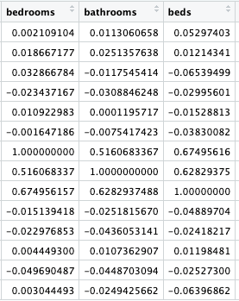
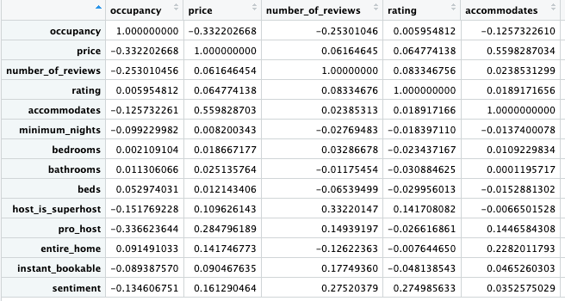
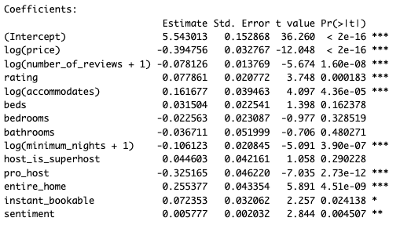

Variables Omitted from Linear Regression - Paris
Steps Taken to Decide which Variables to Omit
Correlation Matrix:
Multicollinearity between “beds”, ”bathrooms”, and ”bedrooms”
Checking Coefficients:
“bedrooms”, “beds” and “bathrooms” have no significance
“host_is_superhost” also had no significance
After removing minimum nights and pro host, the significance of “number_of_reviews” decreased
Variables Ultimately Removed:
Host_is_superhost
Bedrooms
Beds
Bathrooms
Notes:
Similar to the Miami Regression, we checked the Paris data for multicollinearity as a first step.
We found that there was multicollinearity between bedrooms, bathrooms and beds.
Accommodates did not have multicollinearity against these variables in the Paris dataset
We also ran the regression model for the Paris data to confirm our initial findings
Here we can see that beds, bedrooms and bathrooms do not have any significance when included in the model
Differently from the Miami dataset, host_is_superhost did not have any significance, while pro_host did!
These variables were ultimately removed from the regression model.
On the next slide we will compare variables included for each dataset.

Slide 7
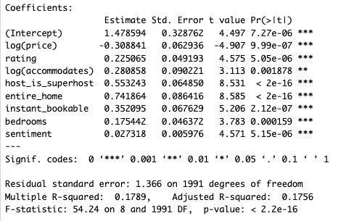
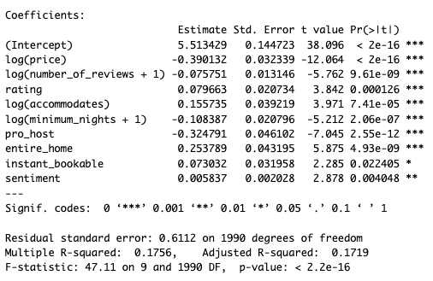
Variables Selected for Linear Regressions
Miami Regression
Paris Regression
Notes:
Here we’ve highlighted the different variables that were included between the final Miami and Paris linear regression models.
For the Miami Regression Model,
Host_is_superhost and bedrooms were included because they had strong significance in the influence of the dependent variable, occupancy
Having the entire home available in a listing had the strongest influence on occupancy
For every 1% increase in Price, there will be a 0.31% decrease in occupancy
Alternatively, for the Paris Regression Model,
Number_of_reviews, Minimum_nights and Pro_Host were included in the regression model
Price had the strongest influence on occupancy - if price increases, occupancy is more likely to decrease
For every 1% increase in price, there will be a 0.39% decrease in occupancy
Hypotheses:
Super Hosts status may be more influential on the dependent variable in Miami because that target audience may value review status more than having a professional property manager host. Professional Hosts may be more influential in Paris because travelling to and staying in Paris could be considered a big trip for some, therefore they would want to ensure that their Airbnb is maintained to professional standards/quality
Super Host status (as defined by Airbnb) is earned by “receiving positive reviews, being responsive, and avoiding cancellations.”
Pro Host (as defined by the data dictionary) are hosts that are professional property managers
Similarly, Minimum Nights is significant for Paris Airbnbs because Paris could be considered a destination vacation
As there are shorter stays, there will be a higher occupancy (as indicated by the negative coefficient value)
The amount of bedrooms at the property may be more influential on occupancy for Miami Airbnbs because although the entire home may be available, there may not be enough bedrooms to accommodate the target guests
These guests may travel in groups that value privacy between groups (like couples or family members)

Slide 8
Topic Models & Word Clouds

Slide 9
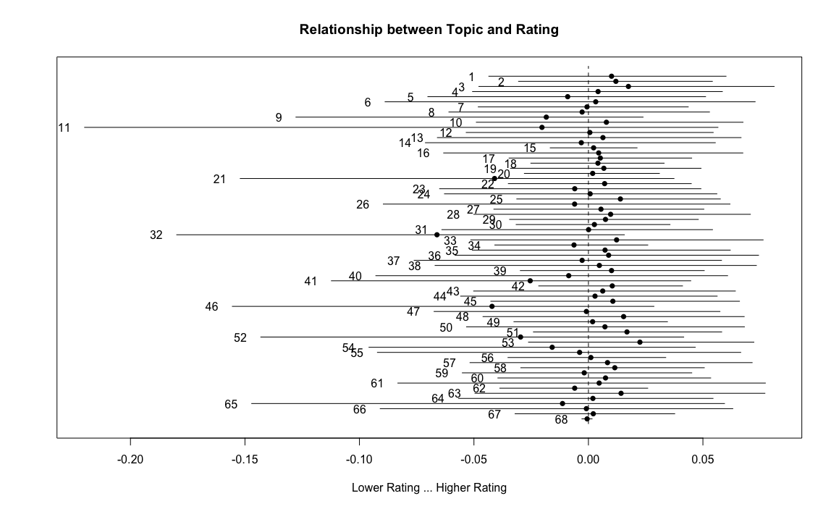
Topic Modeling - Miami
Positive Rating Topics
Topic = 53
Topic = 3
Topic = 51
Negative Rating Topics
Topic = 32
Topic = 46
Topic = 21
Notes:
We ran the r code for the Miami first and found 53,3,51 were the highest rating topics and 32,46,21 were the lowest ratings topics.

Slide 10

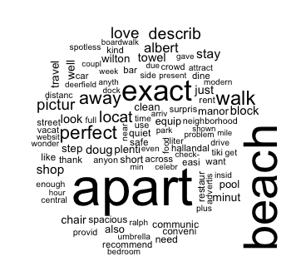

Positive Rating Word Cloud - Miami
Topic 53
Topic 3
Topic 51
Notes:
Some words that we noticed were associated with positive ratings for Miami Airbnb reviews included:
Beach, vacation, exact, perfect, walk, recommend, safe, ambiance
From this we can assume that the Airbnbs with these words received positive reviews because:
The listing was close to the beach
(beach, scenic, close)
It was close to nearby attractions/restaurants
(walk, everything, block, distance, pool, location)
The listing lived up to quality expectations
(everything, need, perfect, advertised, condition, described, clean)

Slide 11
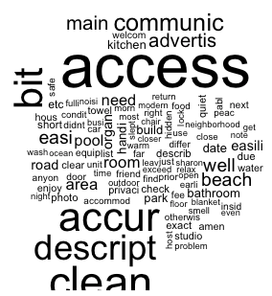

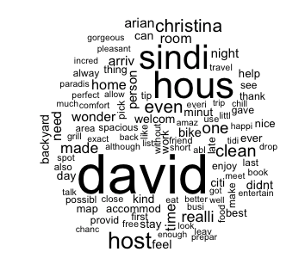
Negative Rating Word Cloud - Miami
Topic 32
Topic 46
Topic 21
Notes:
Some words that we noticed were associated with negative ratings for Miami Airbnb reviews included:
Description, access, cheap, downtown, various names of hosts, communication
From this we can assume that the Airbnbs with these words received negative reviews because:
The listing was difficult to access, not accurate to the description
(access, description, location, beach)
It did not live up to quality expectations
(cheap, hard, away )
There were issues with the host
(various names mentioned frequently, didn’t feel accommodated, communication, help)

Slide 12
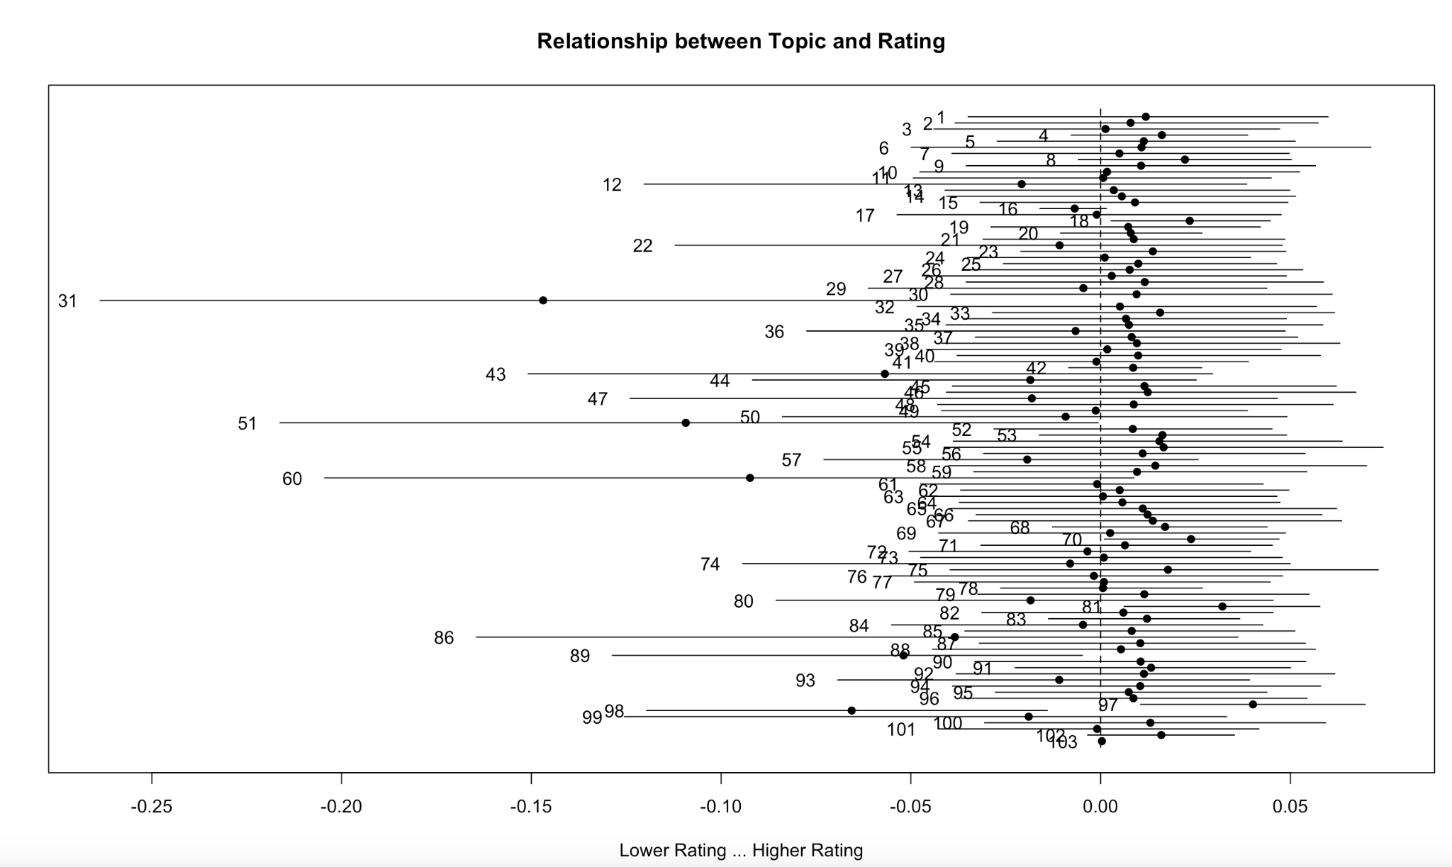
Topic Modeling - Paris
Positive Rating Topics
Topic = 97
Topic = 81
Topic = 18
Negative Rating Topics
Topic = 31
Topic = 51
Topic = 60

Slide 13
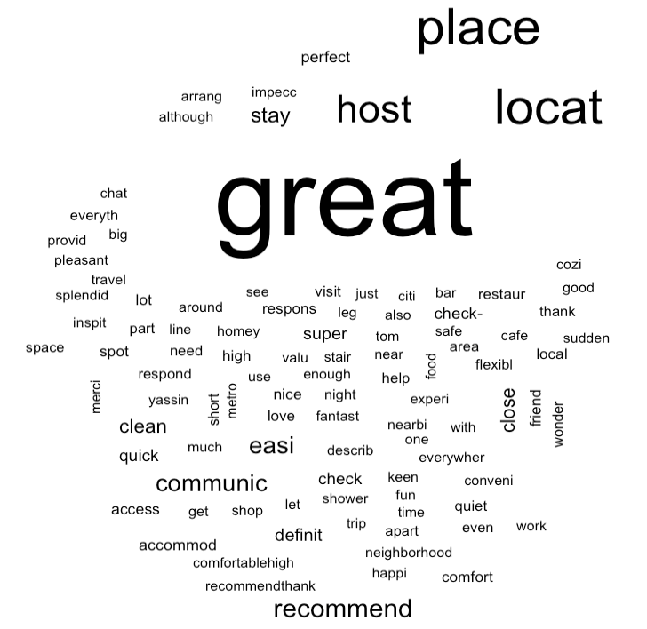
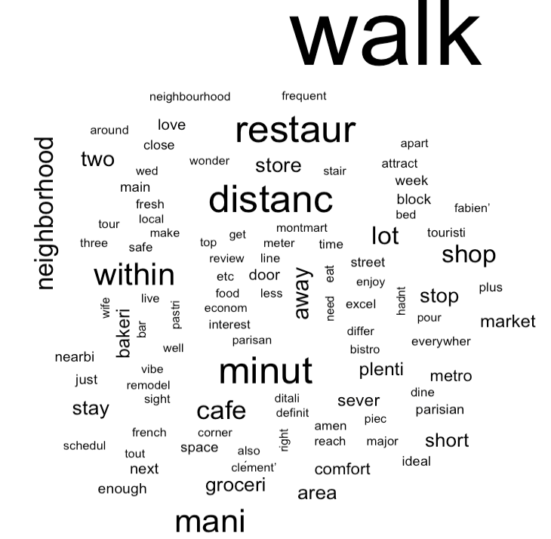

Positive Rating Word Cloud - Paris
Topic 97
Topic 81
Topic 18

Slide 14
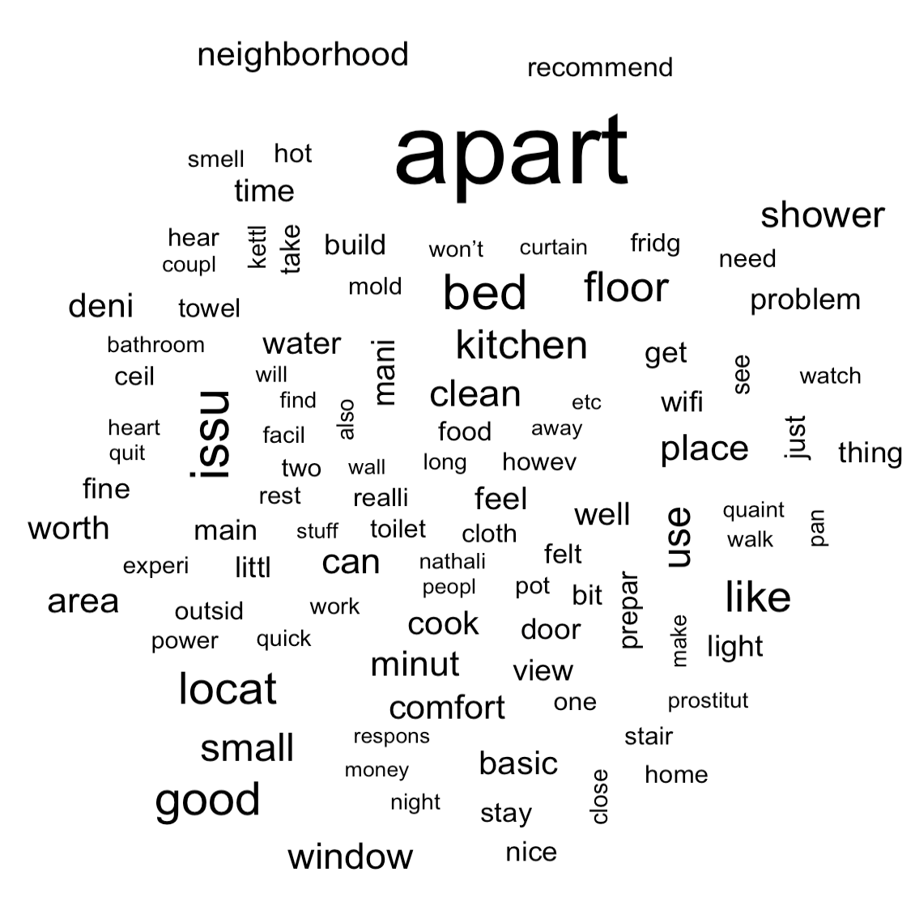
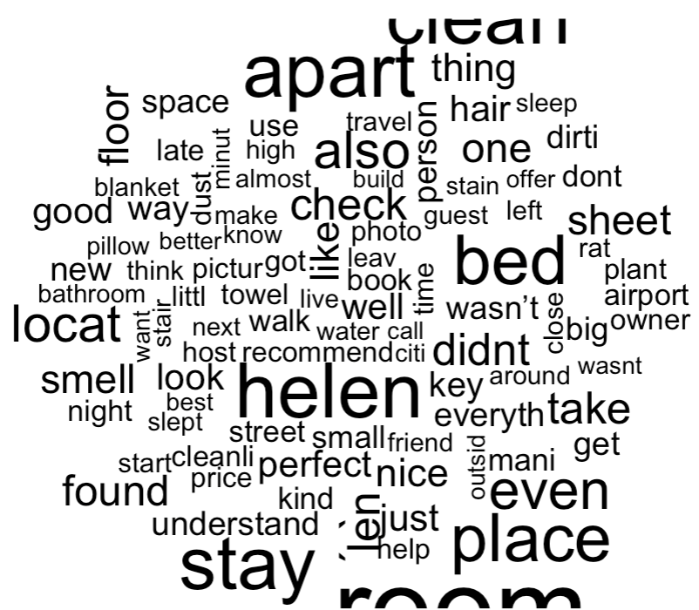
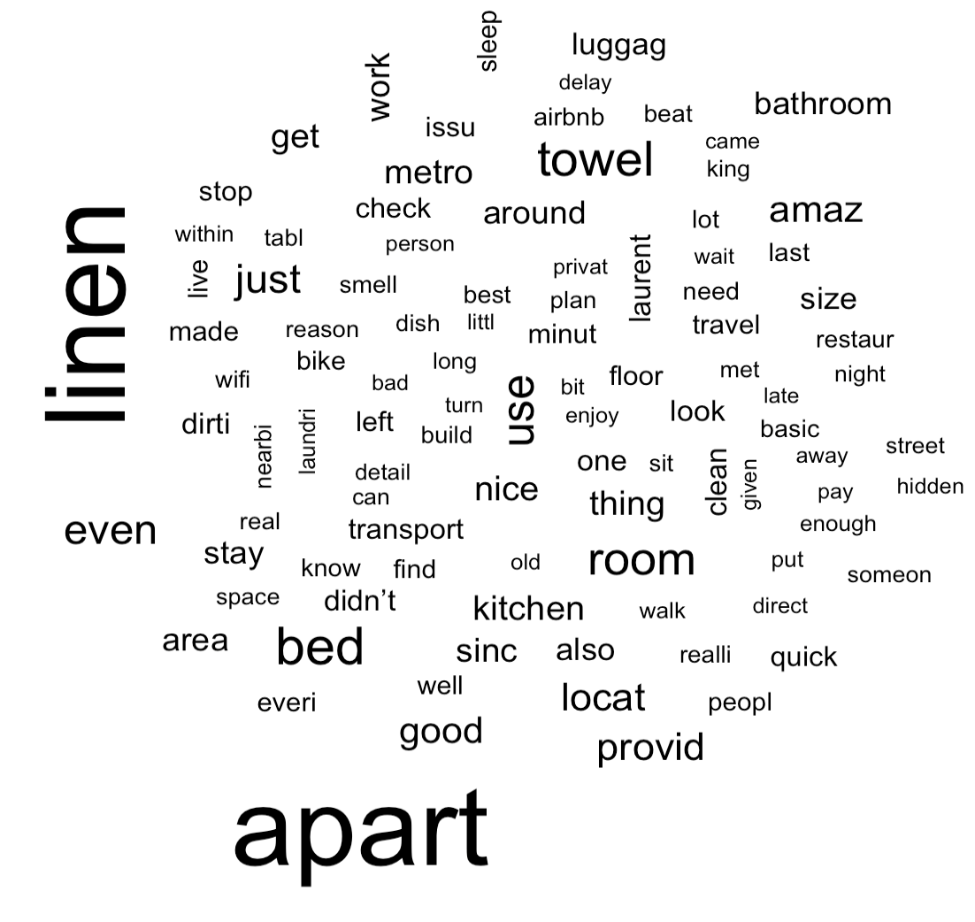
Negative Rating Word Cloud - Paris
Topic 31
Topic 51
Topic 60

Slide 15
Conclusions

Slide 16
Business Recommendations
Miami Market
Linear Regression:
Strongest Coefficient: Entire Home
Differences: Superhost Status and amount of Bedrooms
Topic Modeling:
Positive Ratings for listings close to the beach and other attractions. Also valued cleanliness.
With the linear regression and topic modeling, we can recommend the following:
Provide incentives to hosts for receiving higher reviews, so that there are more Super Hosts in the area.
Focus advertising efforts on listings for entire homes that are closer to the beach and tourist attractions
Partner with local businesses to offer discounts to nearby Airbnb guests
Offer discounted rates to guests for booking a longer stay at an entire home listing
Paris Market
Linear Regression:
Strongest Coefficient: Price
Differences: Pro Host Status, Number of Reviews, Minimum Nights
Topic Modeling:
Positive Ratings were for the stylish and beauty of the stay for the people
With the linear regression and topic modeling, we can recommend the following:
Focus on enhancing the guest experience to capitalize on positive ratings related to the stylishness and beauty of stays.
Given that price is the strongest coefficient in linear regression analysis, consider optimizing pricing strategies to maximize occupancy and profitability. This could involve adjusting prices based on demand fluctuations, competitor analysis, and seasonal trends.
Additionally, consider offering discounts or promotions to incentivize bookings during off-peak periods

Slide 17
Research Project Recommendations
Extended Demographic Analysis:
Study different age groups, travel reasons, and economic backgrounds in Miami and Paris to customize Airbnb listings.
Comparative Analysis of Host Statuses:
Look into how Superhost and Pro Host statuses affect bookings and guest satisfaction in various locations.
Price Elasticity of Demand Study:
Further explore how changes in price impact bookings in Paris to find the best pricing strategies for higher occupancy and revenue.
Customer Journey Mapping:
Track the guest experience from searching for a rental to after their stay, highlighting areas for improvement.

Slide 18
Appendix

Slide 19
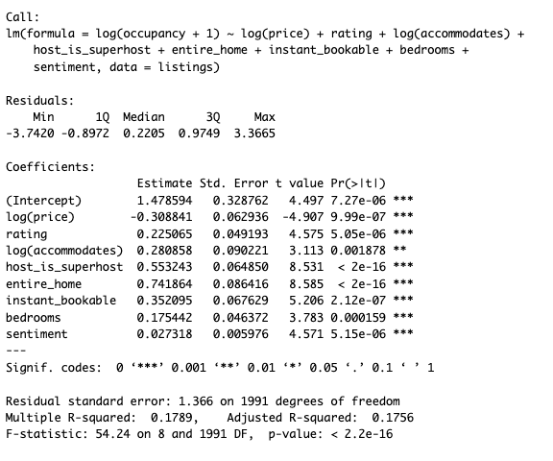
Linear Regression Model - Miami

Slide 20
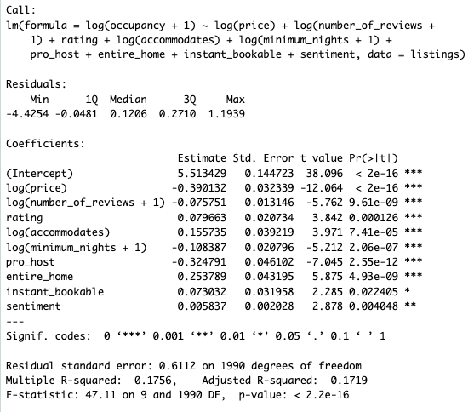
Linear Regression Model - Paris

